Slide 1
WEB DATA VIEW
Aaron VanDeCasteele, Qian Zhang, Pallavi Srivastava

Slide 2
The Story
•If a civil engineer is trying to buy construction equipment, they want to evaluate products and weigh the costs and benefits of each product
•It takes a very long time to extract features the user wants to compare for each product using copy and paste
•Once the user selects the features he wants, the Web Data View Tool will export this to excel and then he can simply sort the categories or run an excel macro to make his decision.
Notes:
start with kmeans and why it doesn’t work as well as DBscan which in that case we put DB SCAN and quick
characteristics of dbscan and hierarchial clustering work well . whats the characteristic?
explain why the distance works

Slide 3
The Problem
It is not possible to assimilate results from multiple websites to compare in general
This is a clustering problem because a lot of web pages use very different criteria to describe and classification is restrictive
Input: The user has to click on a visual block
Output: The corresponding cluster will be highlighted
We extended our domain to any webpage that has a product/specification format

Slide 4
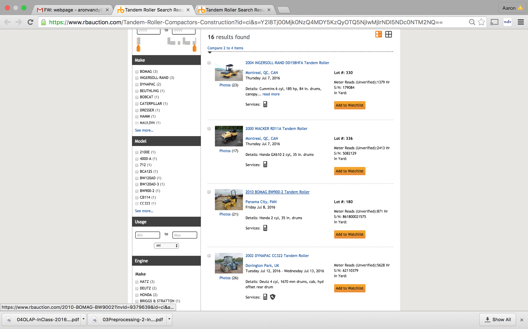

Slide 5
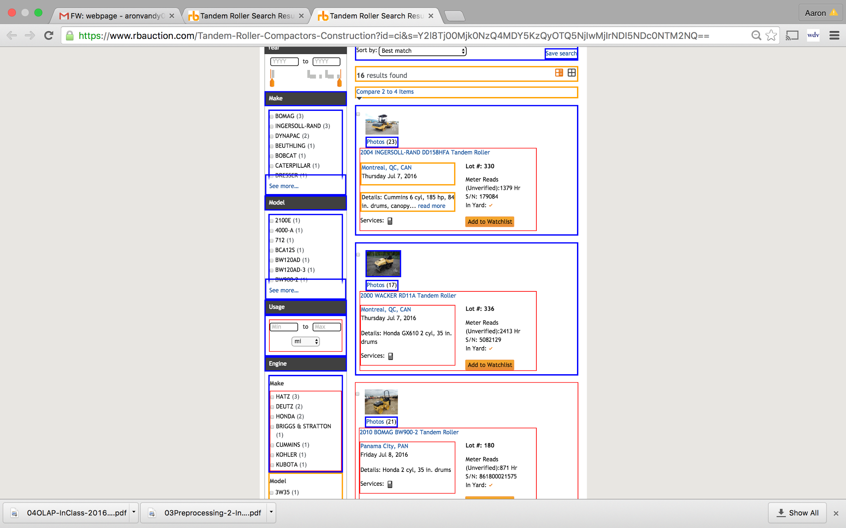

Slide 6
EXPORTED TO EXCEL
Vehicle | Location | Engine Details
2004 INGERSOLL-RAND DD158HFA Tandem Roller | Montreal, QC, CAN | Cummins 6 cyl, 185 hp, 84 in. drums, canopy
2000 WACKER RD11A Tandem Roller | Montreal, QC, CAN | Honda GX610 2 cyl, 35 in. drums
2010 BOMAG BW900-2 Tandem Roller | Panama City, PAN | Honda 2 cyl, 35 in. drums
Notes:
You can use this data to then sort by the features you want to compare

Slide 7
Feature Selection
Issue:
Complex web pages have several thousand attributes and many of do not have numeric values. Many of them are further branched
Solution :
string and/or numerical
One-hot encoding
Variance Threshold method for filtering attributes, but because of the principle of the algorithm, the results obtained diluted the important attributes
In our domain “Shape and location of one visual block usually can indicate its content or type.” so we focussed on Numeric Attributes

Slide 8
Manual Model
Manually cluster features based on key attributes
2. For example the images would always have a png or jpeg tag
3. The title Font would usually be larger than a threshold value etc.
4. Limiting as different web pages use very different specifications criteria

Slide 9
Model Selection
Issue:
From common algorithms KMeans, DBSCAN, Hierarchical Clustering,Which one is suitable for our problem?
Solution :
Trial and Error on KMeans vs DBSCAN/Hierarchial algorithms

Slide 10
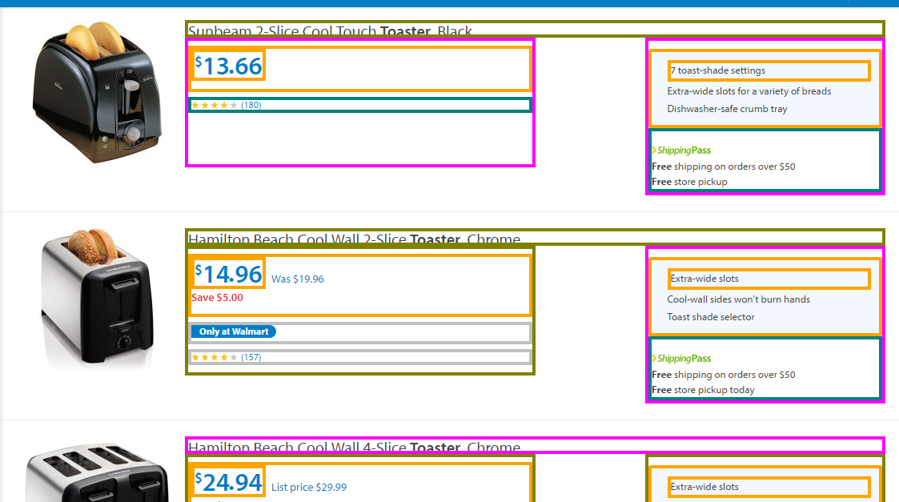
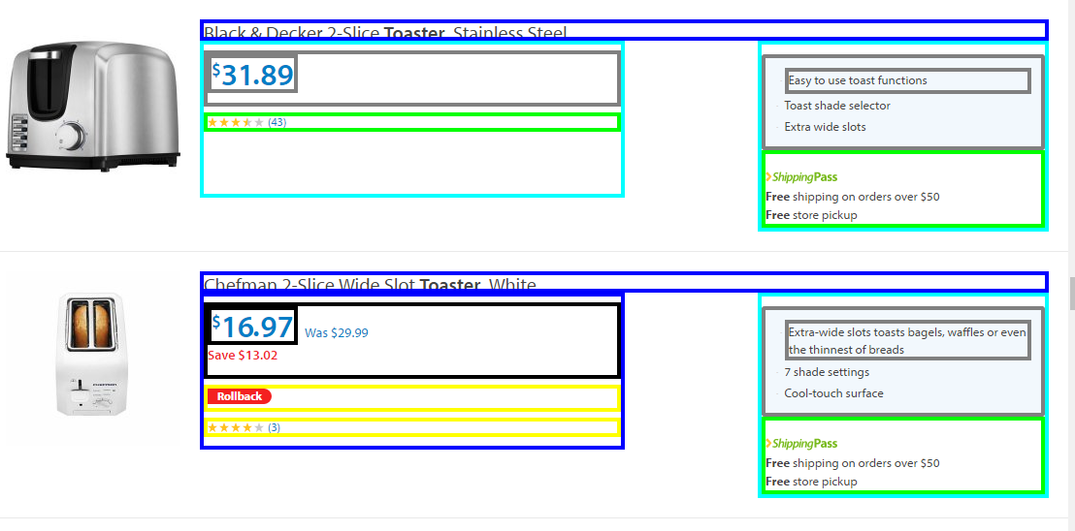
KMeans
Both screenshots are from the same webpage. Left one from the top of the page and right one from the bottom of the page.

Slide 11
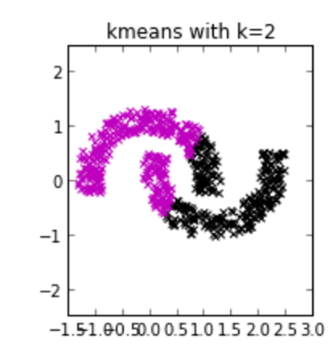
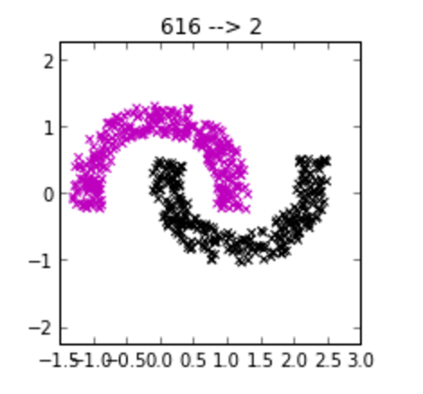
K-Means- Why it Fails
K-Means
K-means chooses centroids to minimize inertia between clusters
2) It is implicitly designed for Euclidean distance
3) Assumes clusters are convex and isotropic
4) The K value differs based on the webpage and an approximate user guess was often wrong
5) No way to change the weights of specific attributes ( in scikit )

Slide 12
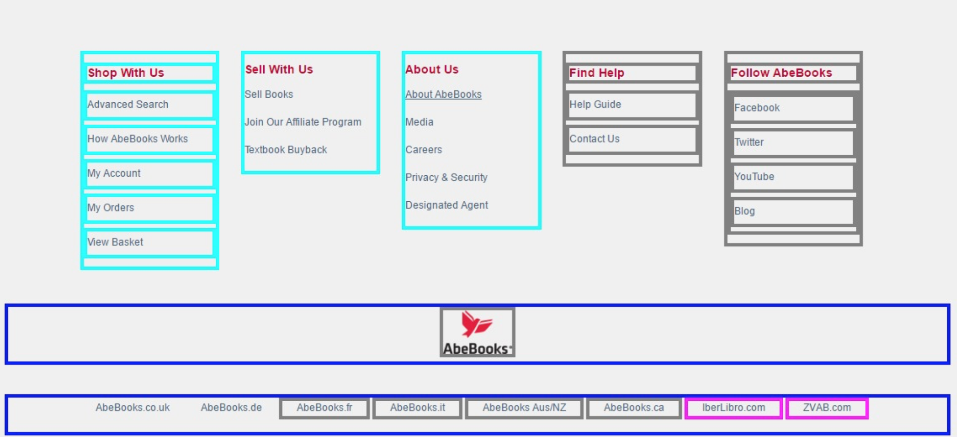
K-Means- Why it Fails
noise is clustered a lot

Slide 13
DB- SCAN/Hierarchial - Why they Work
DB-Scan
1) Is a density based Algorithm
2) Has the concept of core samples and outliers (for noise)
3) Different clusters in our domain have approximately the same density because of the structure even though our data might not always be convex
4) Don’t need to specify number of clusters
5) MinPts and E can be selected based on domain knowledge. We tuned E.

Slide 14
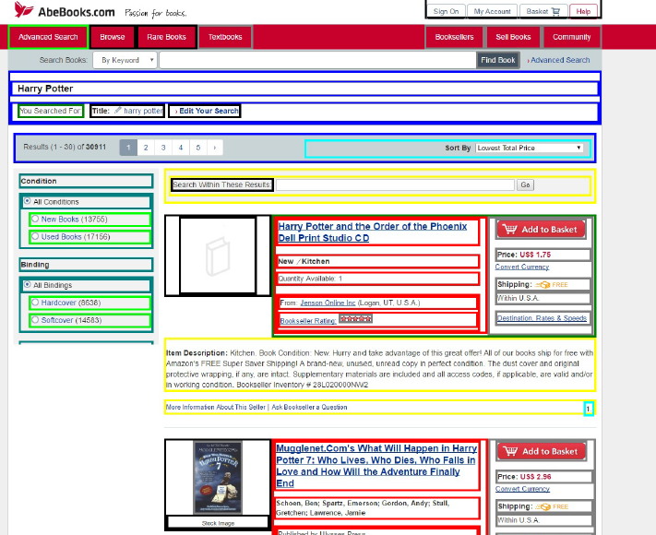
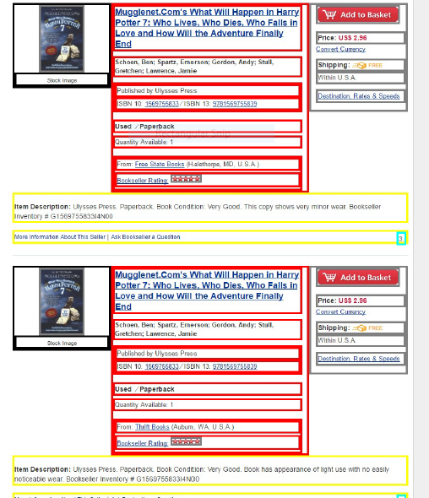
DB- SCAN/Hierarchial - Why they Work

Slide 15
Weight of Features
Issue:
Usually, the features have different importance for the visual blocks. We need to assign a weight distribution for the features.
Solution :
Scale the feature values.
Normalize all feature values between (0,1).
Multiply the weight of each feature to the normalized values.

Slide 16
Parameters Tuning
Issue:
Default parameters of the clustering algorithms usually not work. For our specific problem, certain parameters have to be tuned to have a better performance.
Solution:
Parameters for the clustering algorithms we tried
Number of the clusters :(KMeans, Hierarchical Clustering)
Neighborhood size, i.e., epsilon and min number of samples: (DBSCAN)

Slide 17
Distance Measures
1) We tried Euclidean as well as Manhattan distances
2) ‘’Reducing the exponent makes the other features play a bigger role in the distance calculation. The lower the exponent the less relevant a high difference in some given dimension will be’’
3) When we explicitely added a lot of weight to some attributes Euclidean performs better but for the general case of equally weighted attributes Manahatten is better

Slide 18
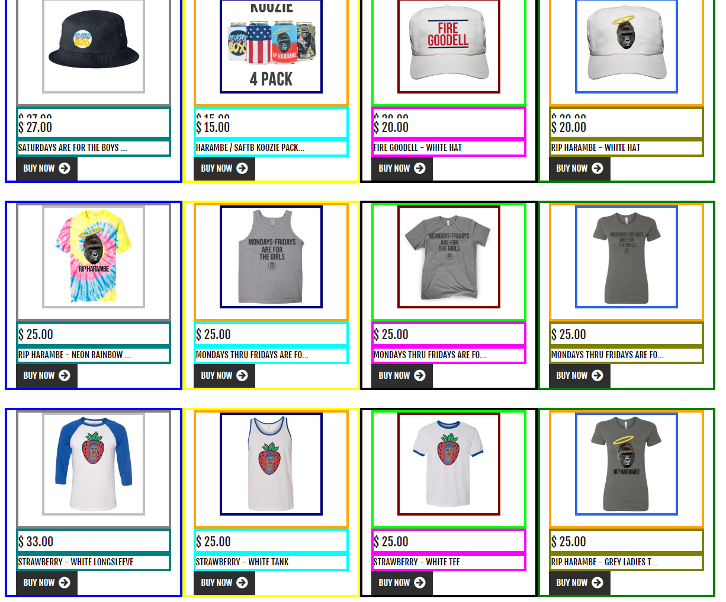
Failures/Challenges
Without considering weight of features:

Slide 19
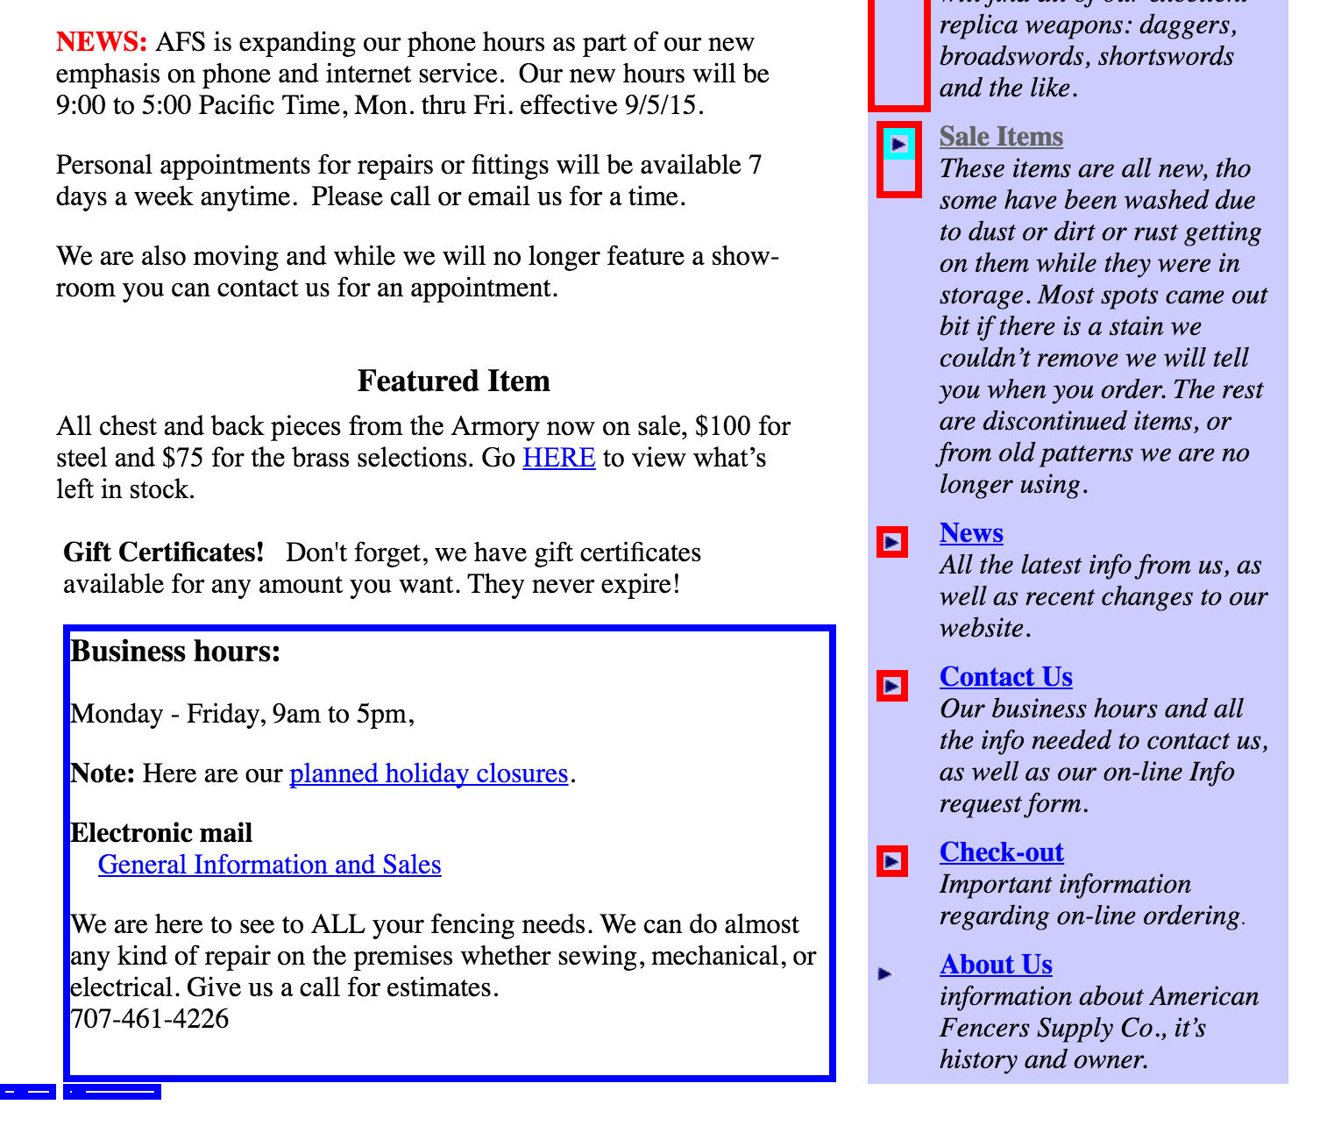
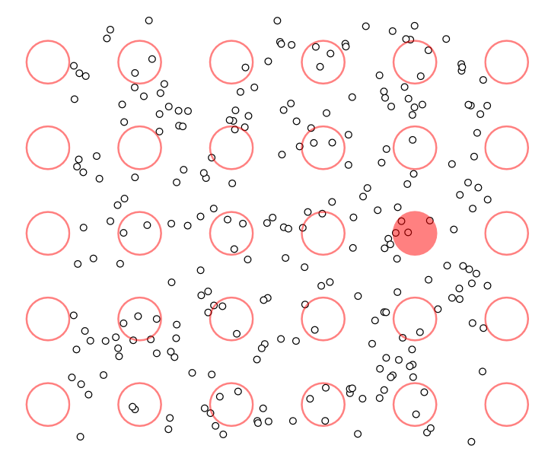
Failures/Challenges
Uneven density of points
http://www.naftaliharris.com/blog/visualizing-dbscan-clustering/

Slide 20
Statistical Results
The reason why we did not use common clustering performance criteria is because the visual performance is more important to our users.
2) Our Metric :
Pictures
Price
Rating
Specification
Noise
Satisfactory >= 75%
Fair >= 60 %< 75%
Not Satisfactory <60%

Slide 21
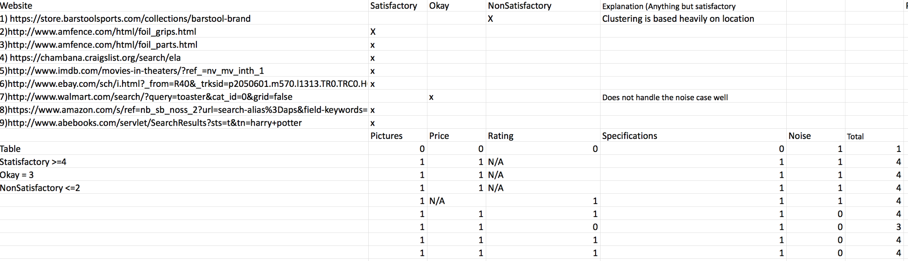
Statistical Results

Slide 22
Thank You!!!

